Slide 1

Exploring the tolerance of Pacific geoduck to low pH through comparative physiology, genomics, and DNA methylation
Shelly A. Trigg
(strigg@uw.edu)
School of Aquatic and Fishery Sciences, University of Washington
Co-authors: Hollie M. Putnam and Samuel J. Gurr, University of Rhode Island
Steven B. Roberts and Kaitlyn R. Mitchell, University of Washington
Brent Vadopalas, Washington Sea Grant
Matthew Henderson, Jamestown S’klallam Point Whitney Hatchery
12-minute talk
Notes:
Hi My name is Shelly Trigg and I am a postdoc in the School of Aquatic and Fishery Sciences at the University of Washington. Today I’m going to be sharing a culmination of a series of experiments looking at pH influence on the physiology of the Pacific geoduck. I want to start by acknowledging the co-authors of these projects Hollie Putnam and Sam Gurr at University of Rhode Island, my advisor Steven Roberts, and Kaitlyn Mitchell at the University of Washington, Brent Vadopalas WSG, and Matt Henderson at Jamestown Point Whitney hatchery. This work is funded by the USDA Foundation for Food and Agriculture Research

Slide 2
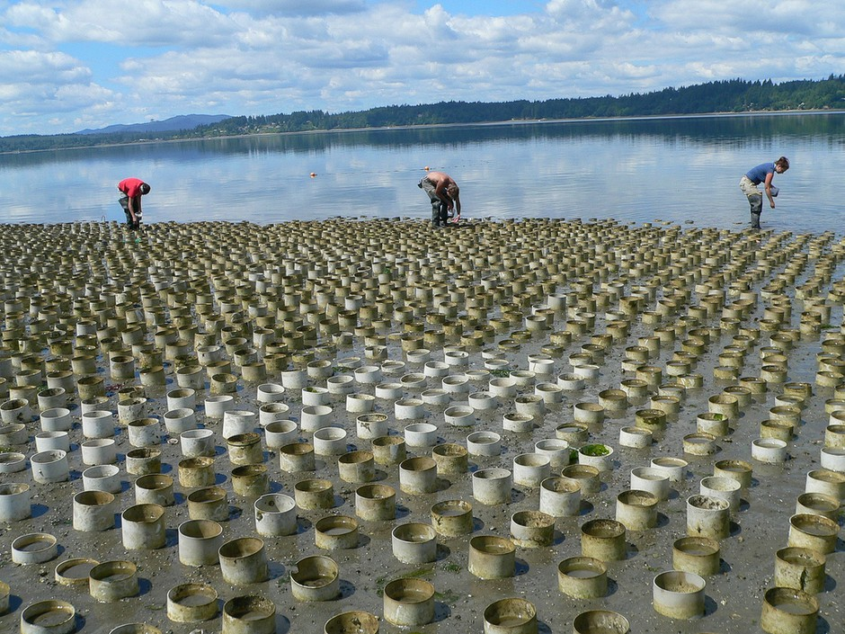
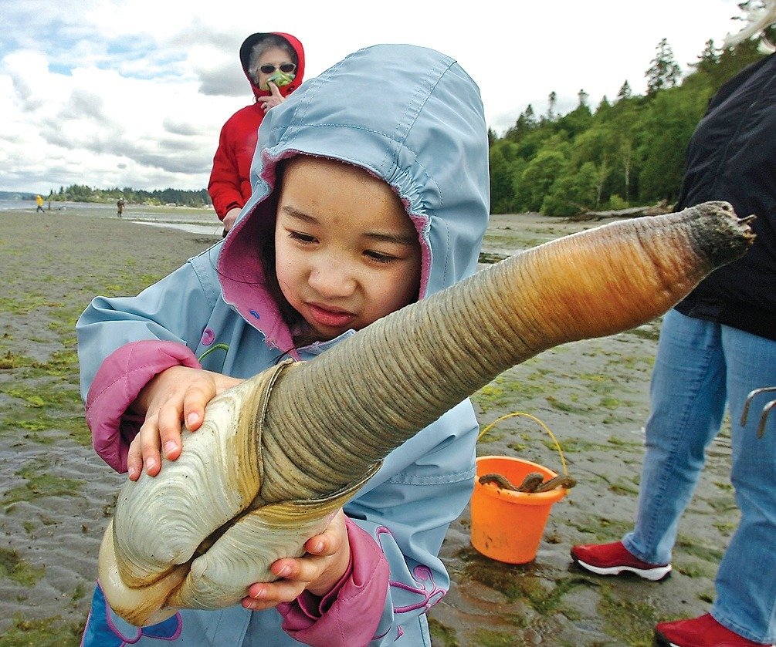
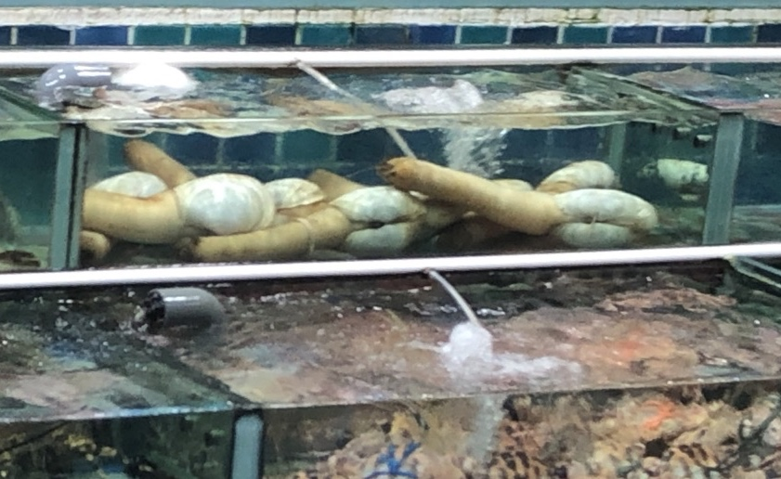
Pacific Geoduck are important
Among most valuable farmed shellfish on a per acre basis
>$20 M in annual sales in Washington alone
Serve ecosystems as biofilters and prey
Tribal sustenance
Notes:
If this is your first introduction to Pacific Geoduck, these are large clams tat inhabit the Northeastern Pacific from Alaska down to
Geoduck are important economically being the most valuable farmed shellfish on a per acre basis brining in over 20M in annual sales in WA state alone. They are important ecologically serving as biofilters and as a prey source. And they are important culturally, having sustained tribes by providing a food and revenue source.
The name geoduck = Nisqually for dig deep

Slide 3
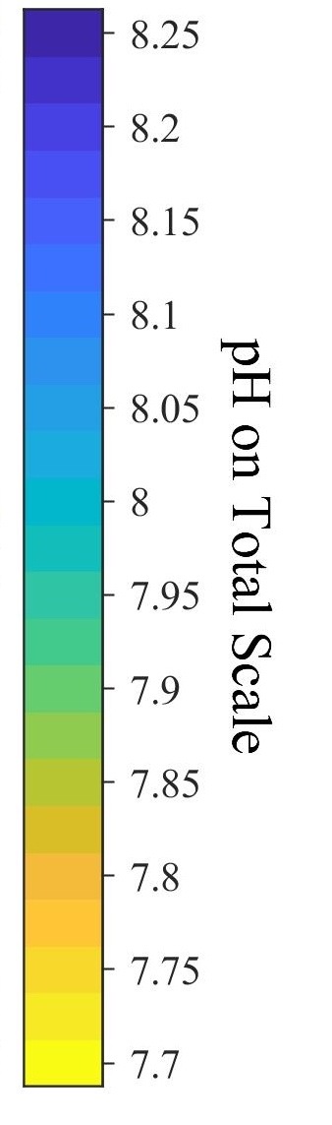
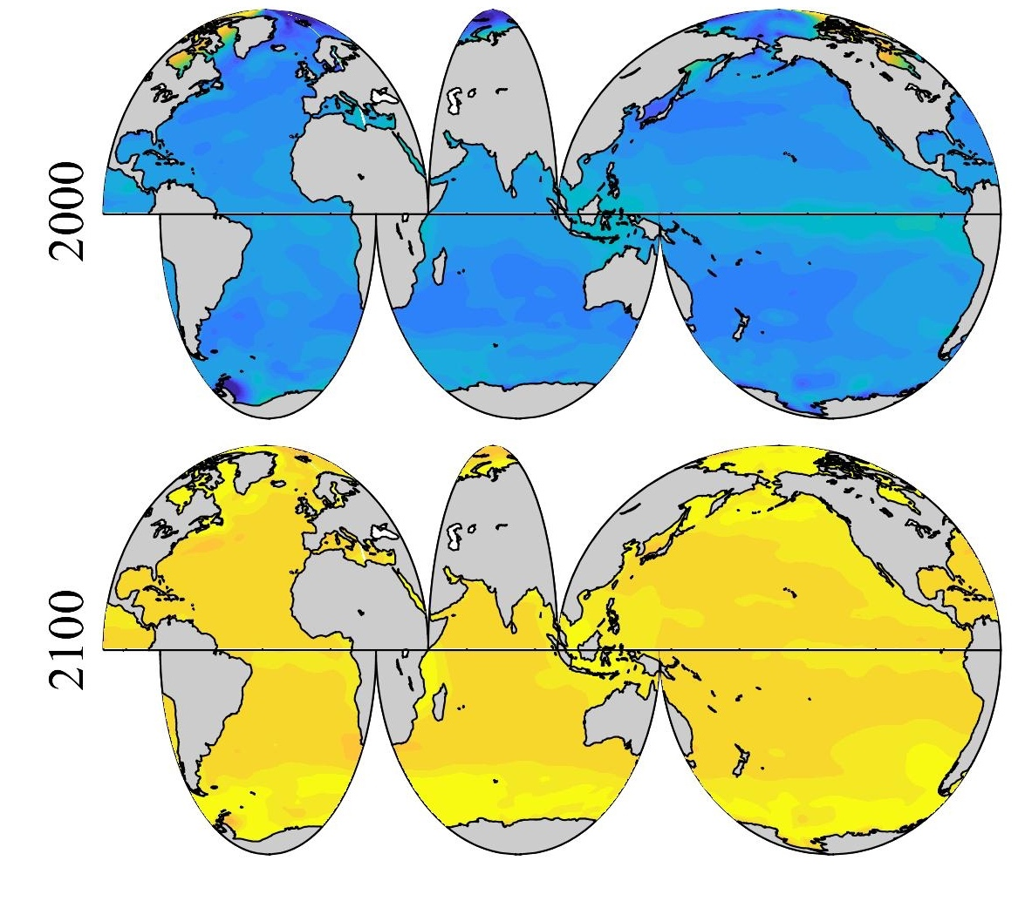
How does pH affect geoduck?
Overarching questions:
How will they fare under ocean acidification conditions predicted for the future?
Could stress conditioning be beneficial for aquaculture?
Surface Ocean pH
Sustainable fisheries and aquaculture production

Slide 4
How does pH affect geoduck?
Overarching questions:
How will they fare under ocean acidification conditions predicted for the future?
Could stress conditioning be beneficial for aquaculture?
Aspects to investigate:
Broodstock performance and reproductive development
Juvenile development
Carry over effects
Notes:
To start investigating these questions, our group and collaborators have been looking at broodstock performance and reproductive development, juvenile development, and carry over effects or in other words traits passed from parent to offspring

Slide 5
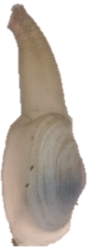
static low pH negatively impacts broodstock survival
Ambient (7.8)
93 days
Low pH (6.8)
Notes:
How will they fare in OA conditions predicted for the future? Could stress conditioning be beneficial in aquaculture?

Slide 6
Impact of static low pH on broodstock
Notes:
How will they fare in OA conditions predicted for the future? Could stress conditioning be beneficial in aquaculture?

Slide 7
static low pH negatively impacts broodstock survival
Notes:
How will they fare in OA conditions predicted for the future? Could stress conditioning be beneficial in aquaculture?

Slide 8
static low pH delays female reproductive development
Spawned and resorbing

Slide 9
static low pH does not delay male reproductive development
Spawned and resorbing

Slide 10
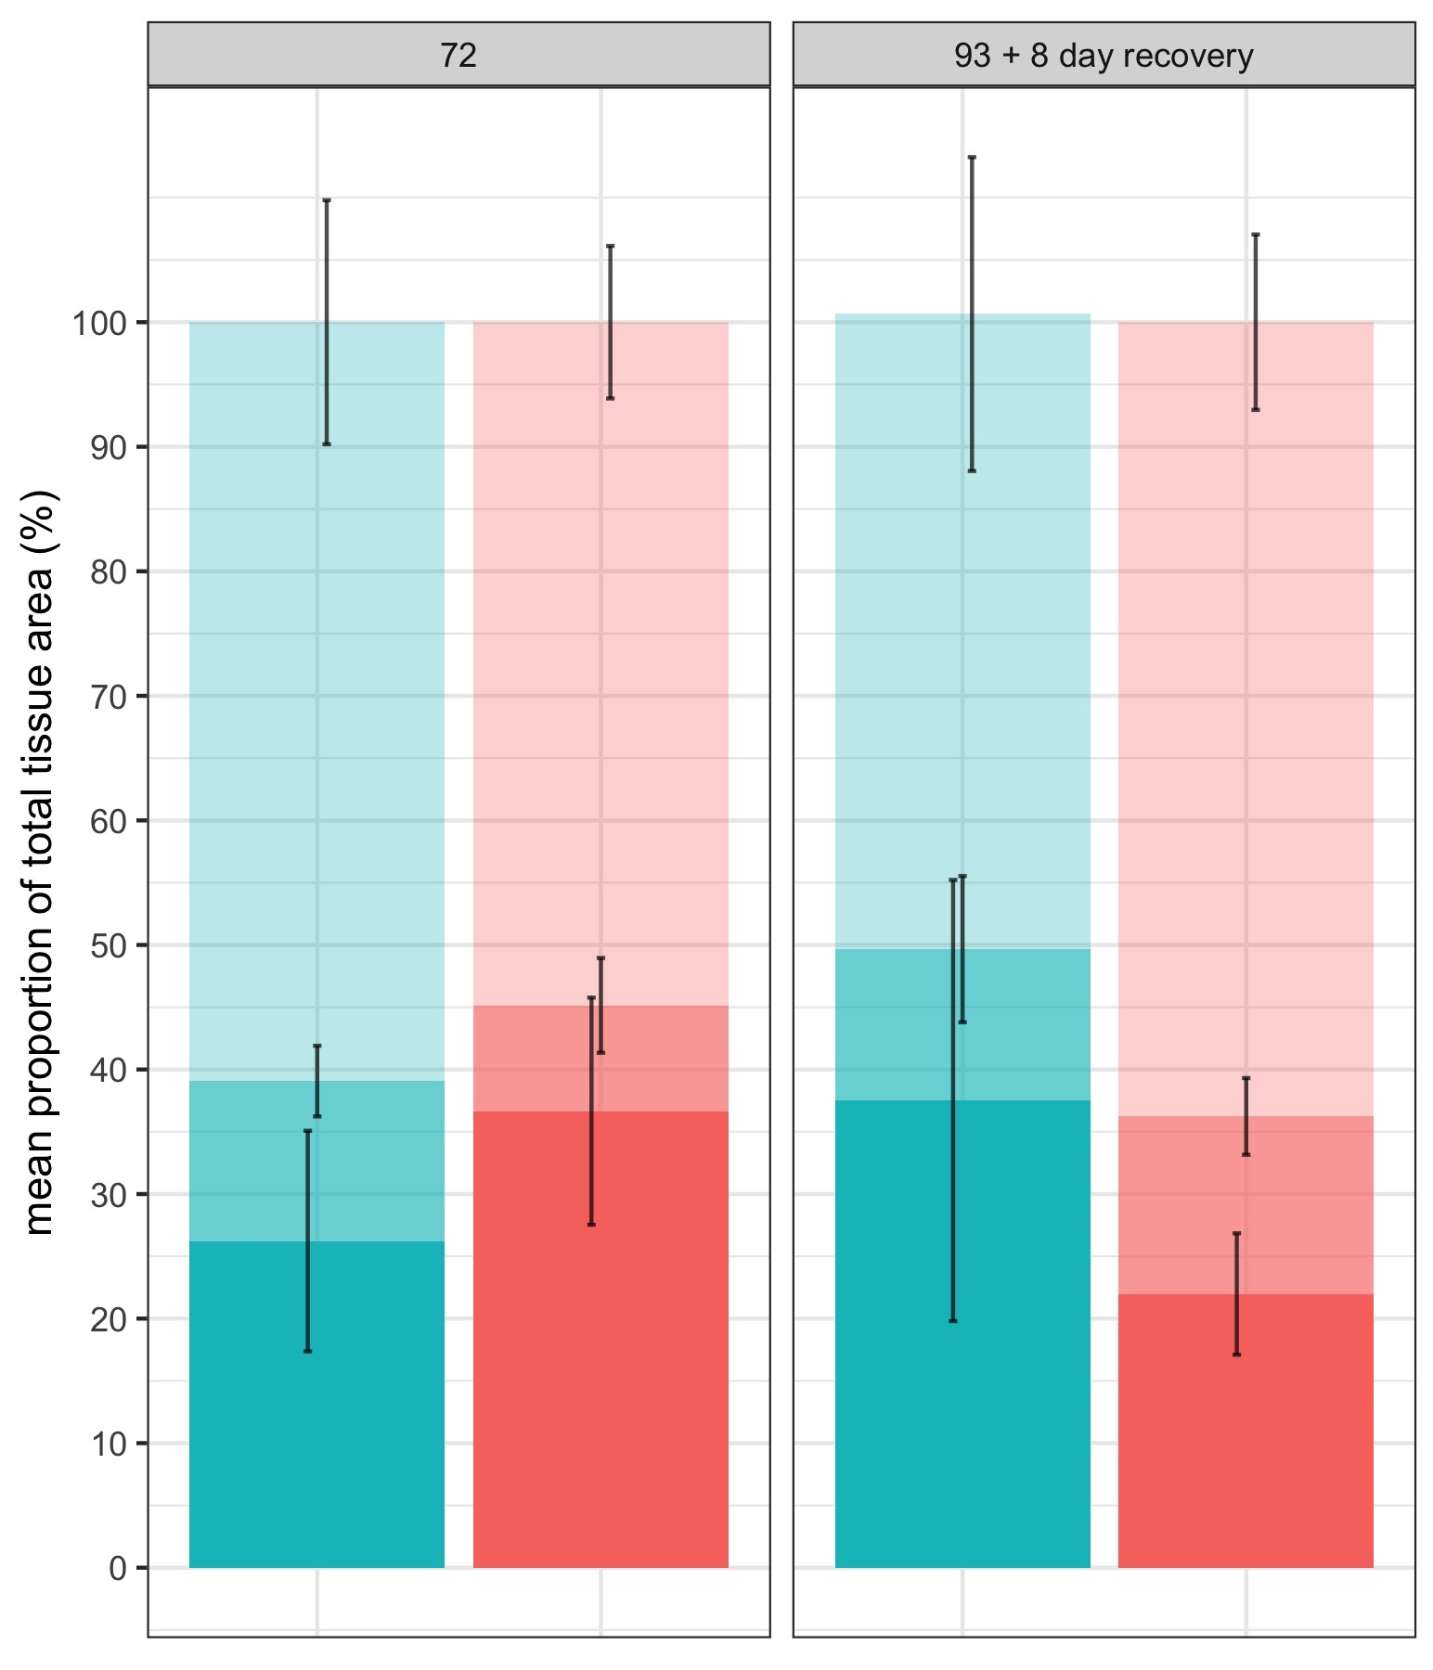
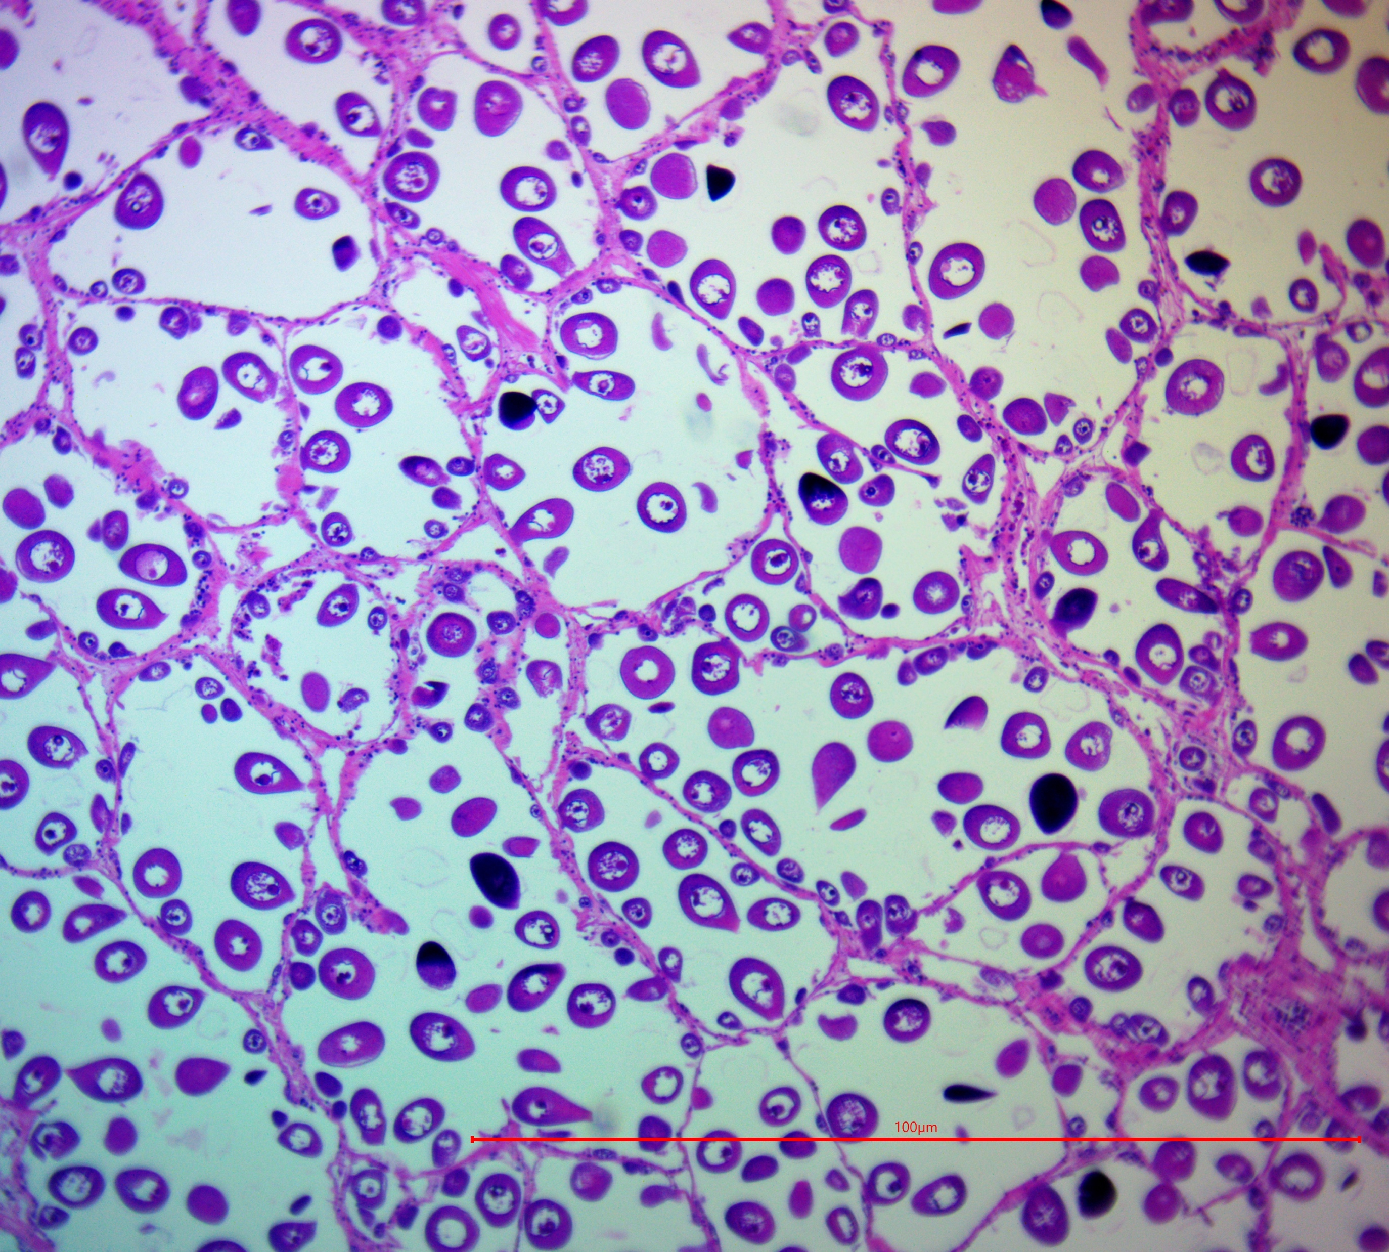
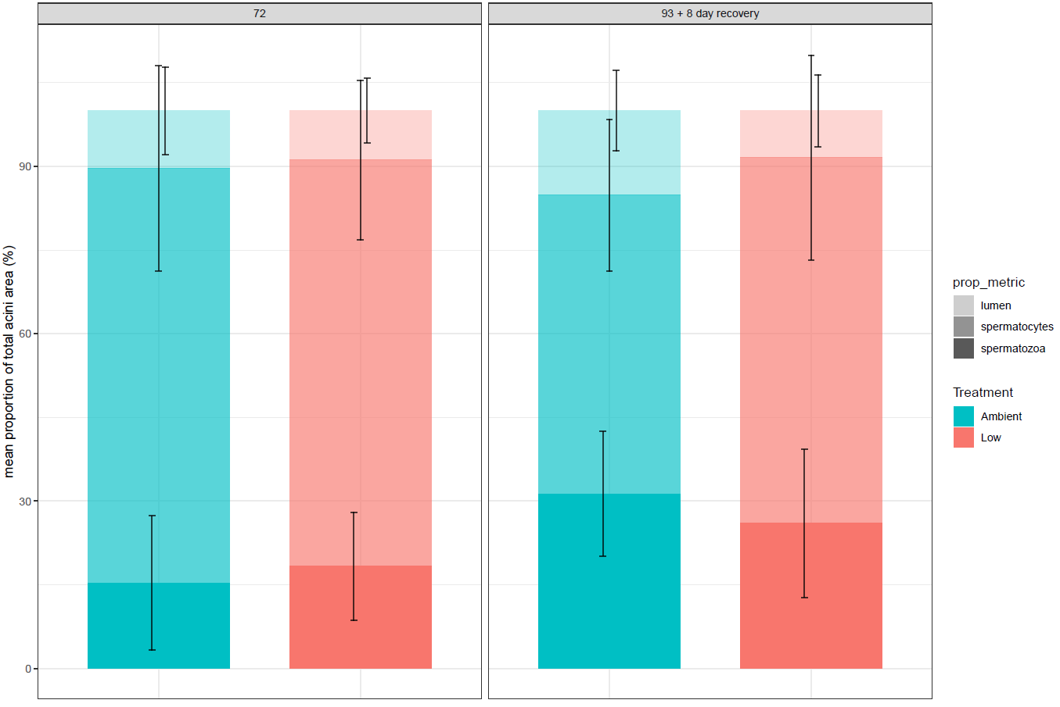
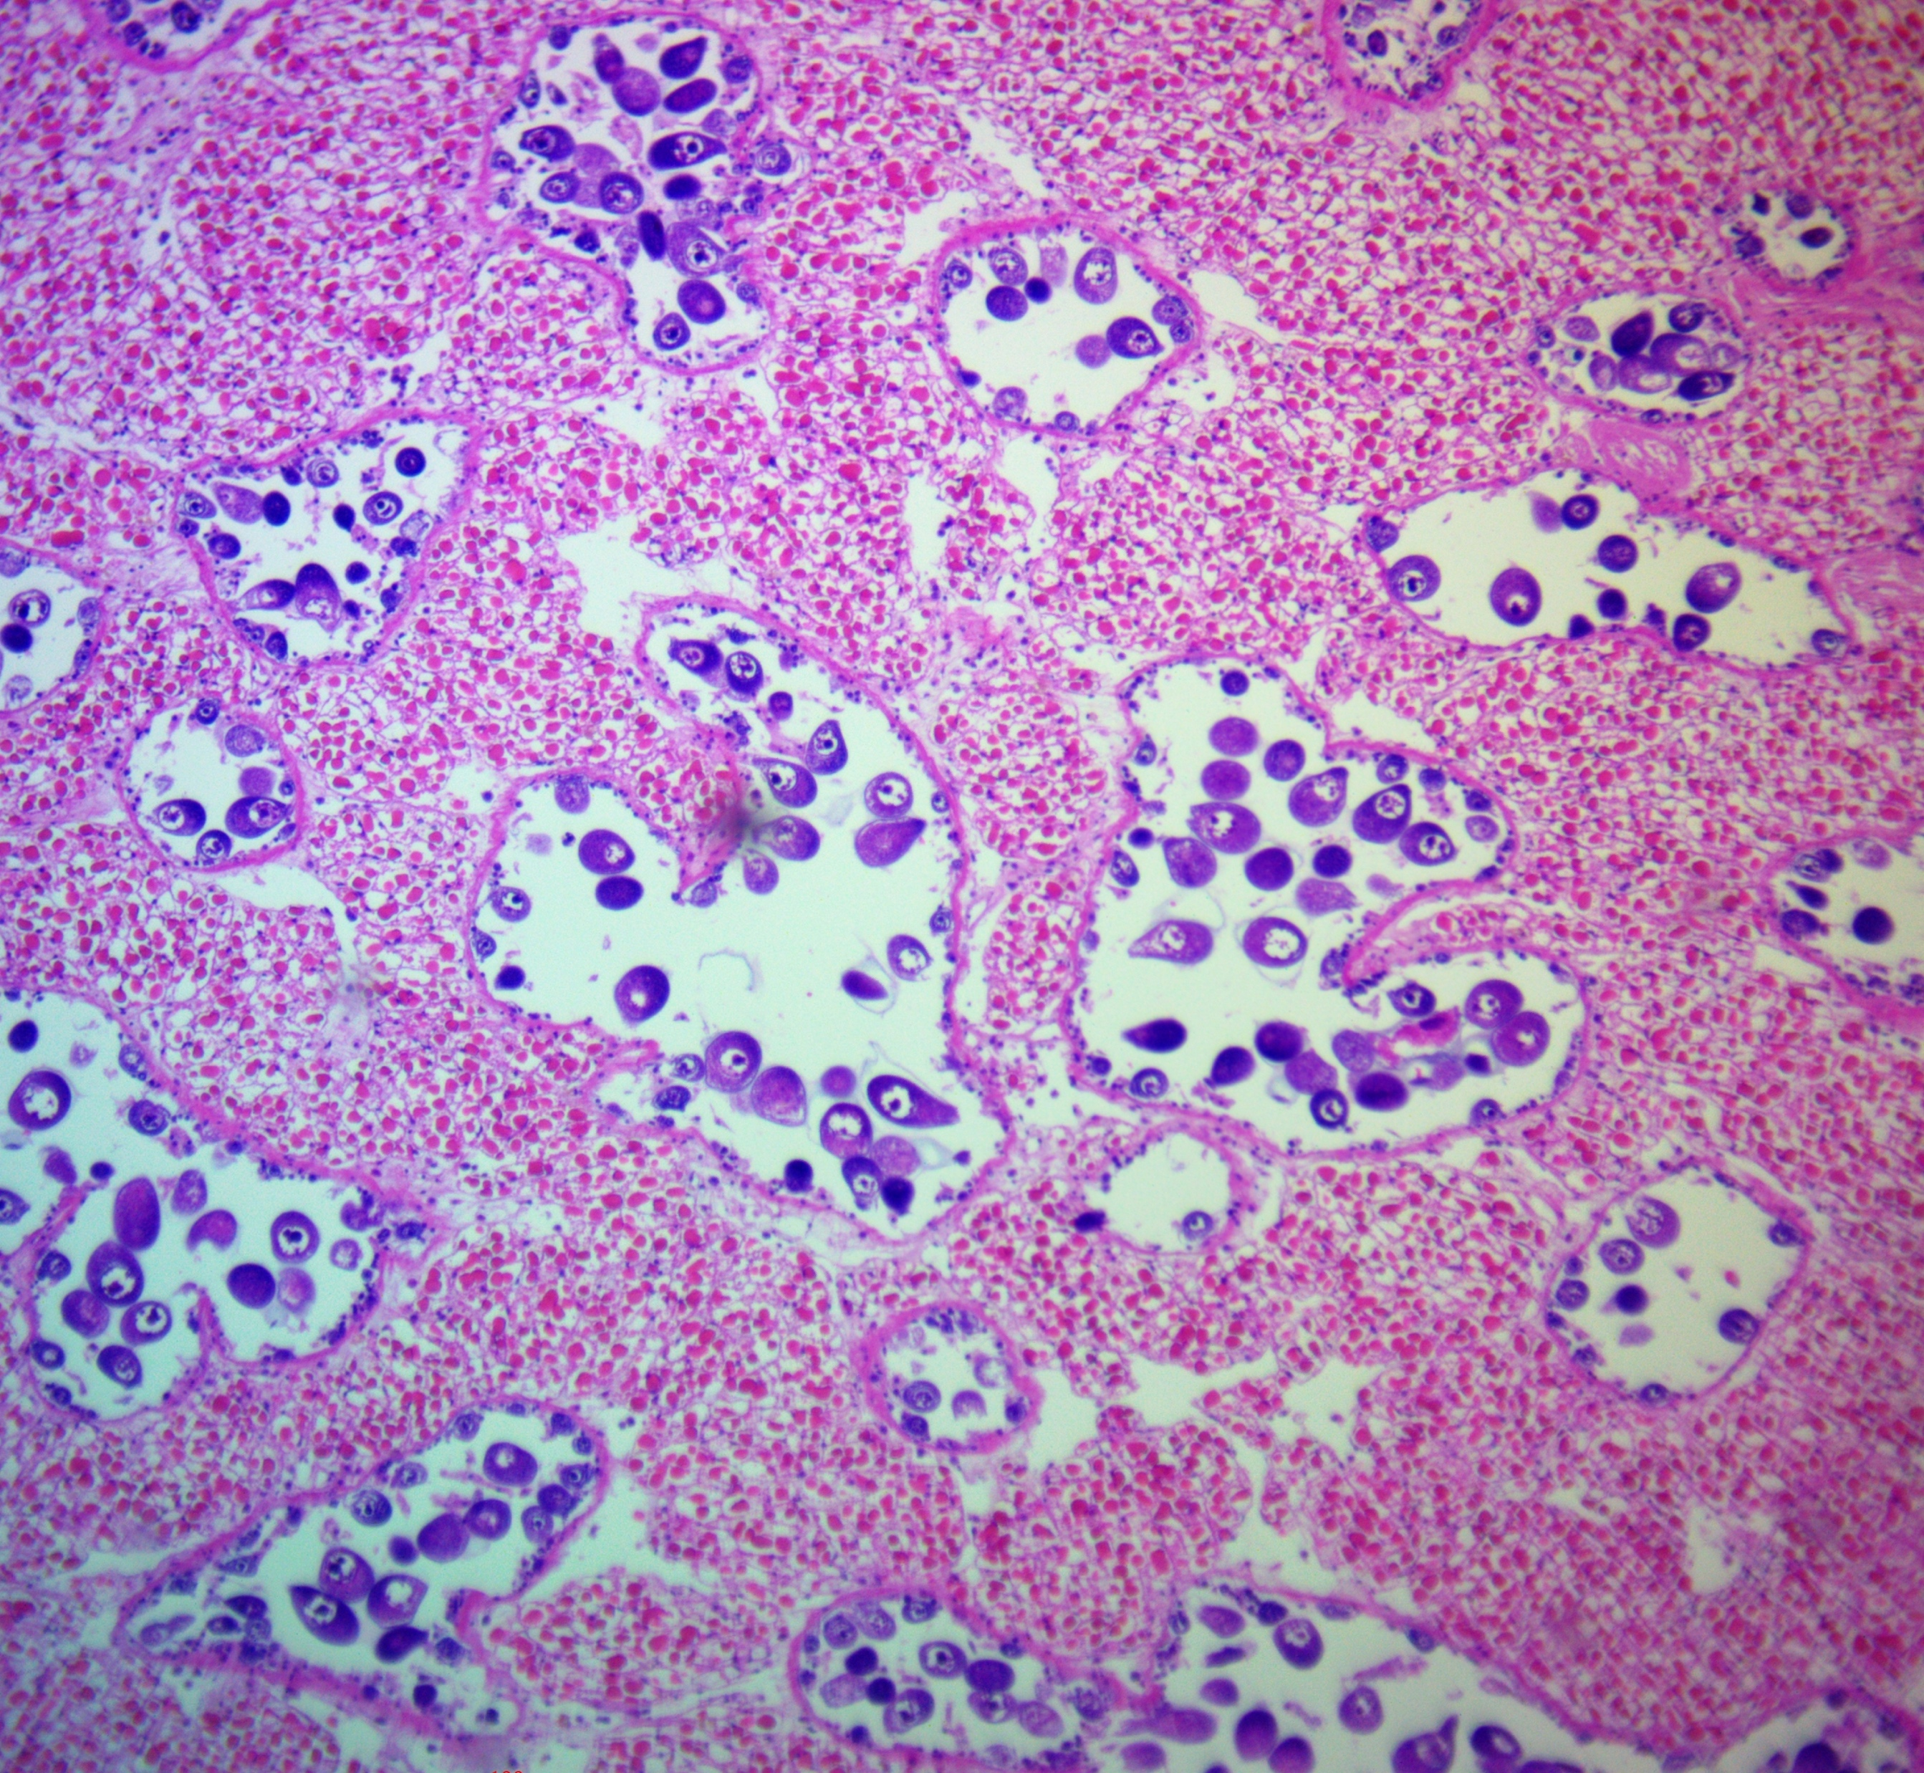
Impact of static pH on broodstock and reproductive development
Delays female reproductive development
Egg size
gonad tissue area
Ambient (8.0)
Doesn’t impact male reproductive development
follicle
follicle
follicle
follicle
gonad tissue area
Low pH (6.8)
egg
egg
egg
egg
lumen
lumen
lumen
lumen
connective
tissue
connective
tissue
connective
tissue
connective
tissue
immature sperm
immature sperm
immature sperm
immature sperm
mature sperm
mature sperm
mature sperm
mature sperm

Slide 11
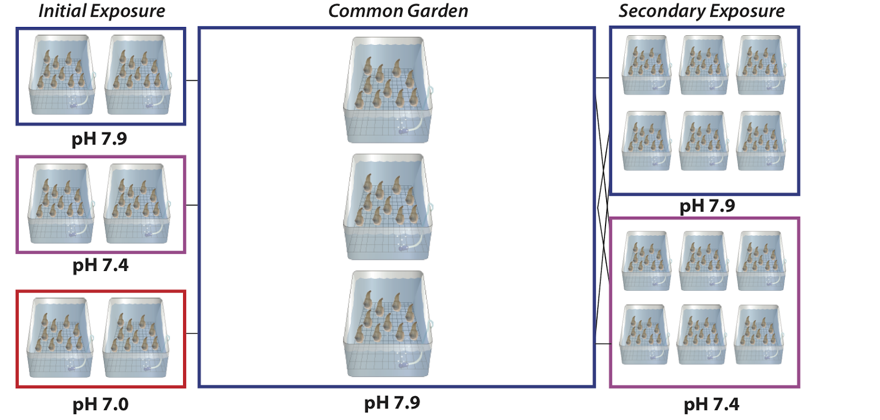

Impact of static pH on juvenile development
Days:
0
23
135
158
Hollie Putnam

Slide 12
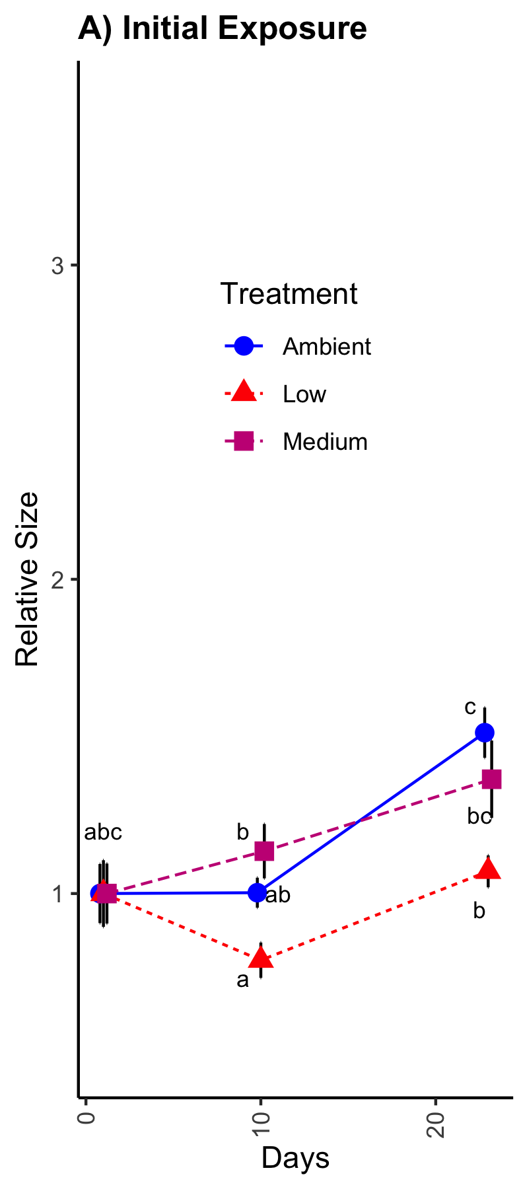
static low pH initial exposure delays juvenile growth
Hollie Putnam

Slide 13
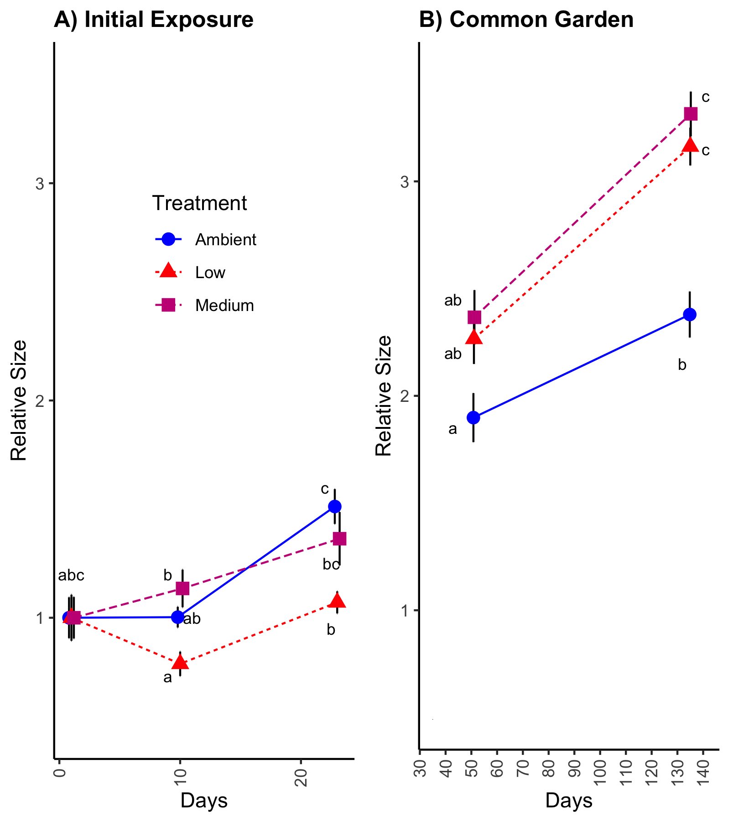
static moderate and low pH initial exposure leads to accelerated growth after common garden
Hollie Putnam

Slide 14
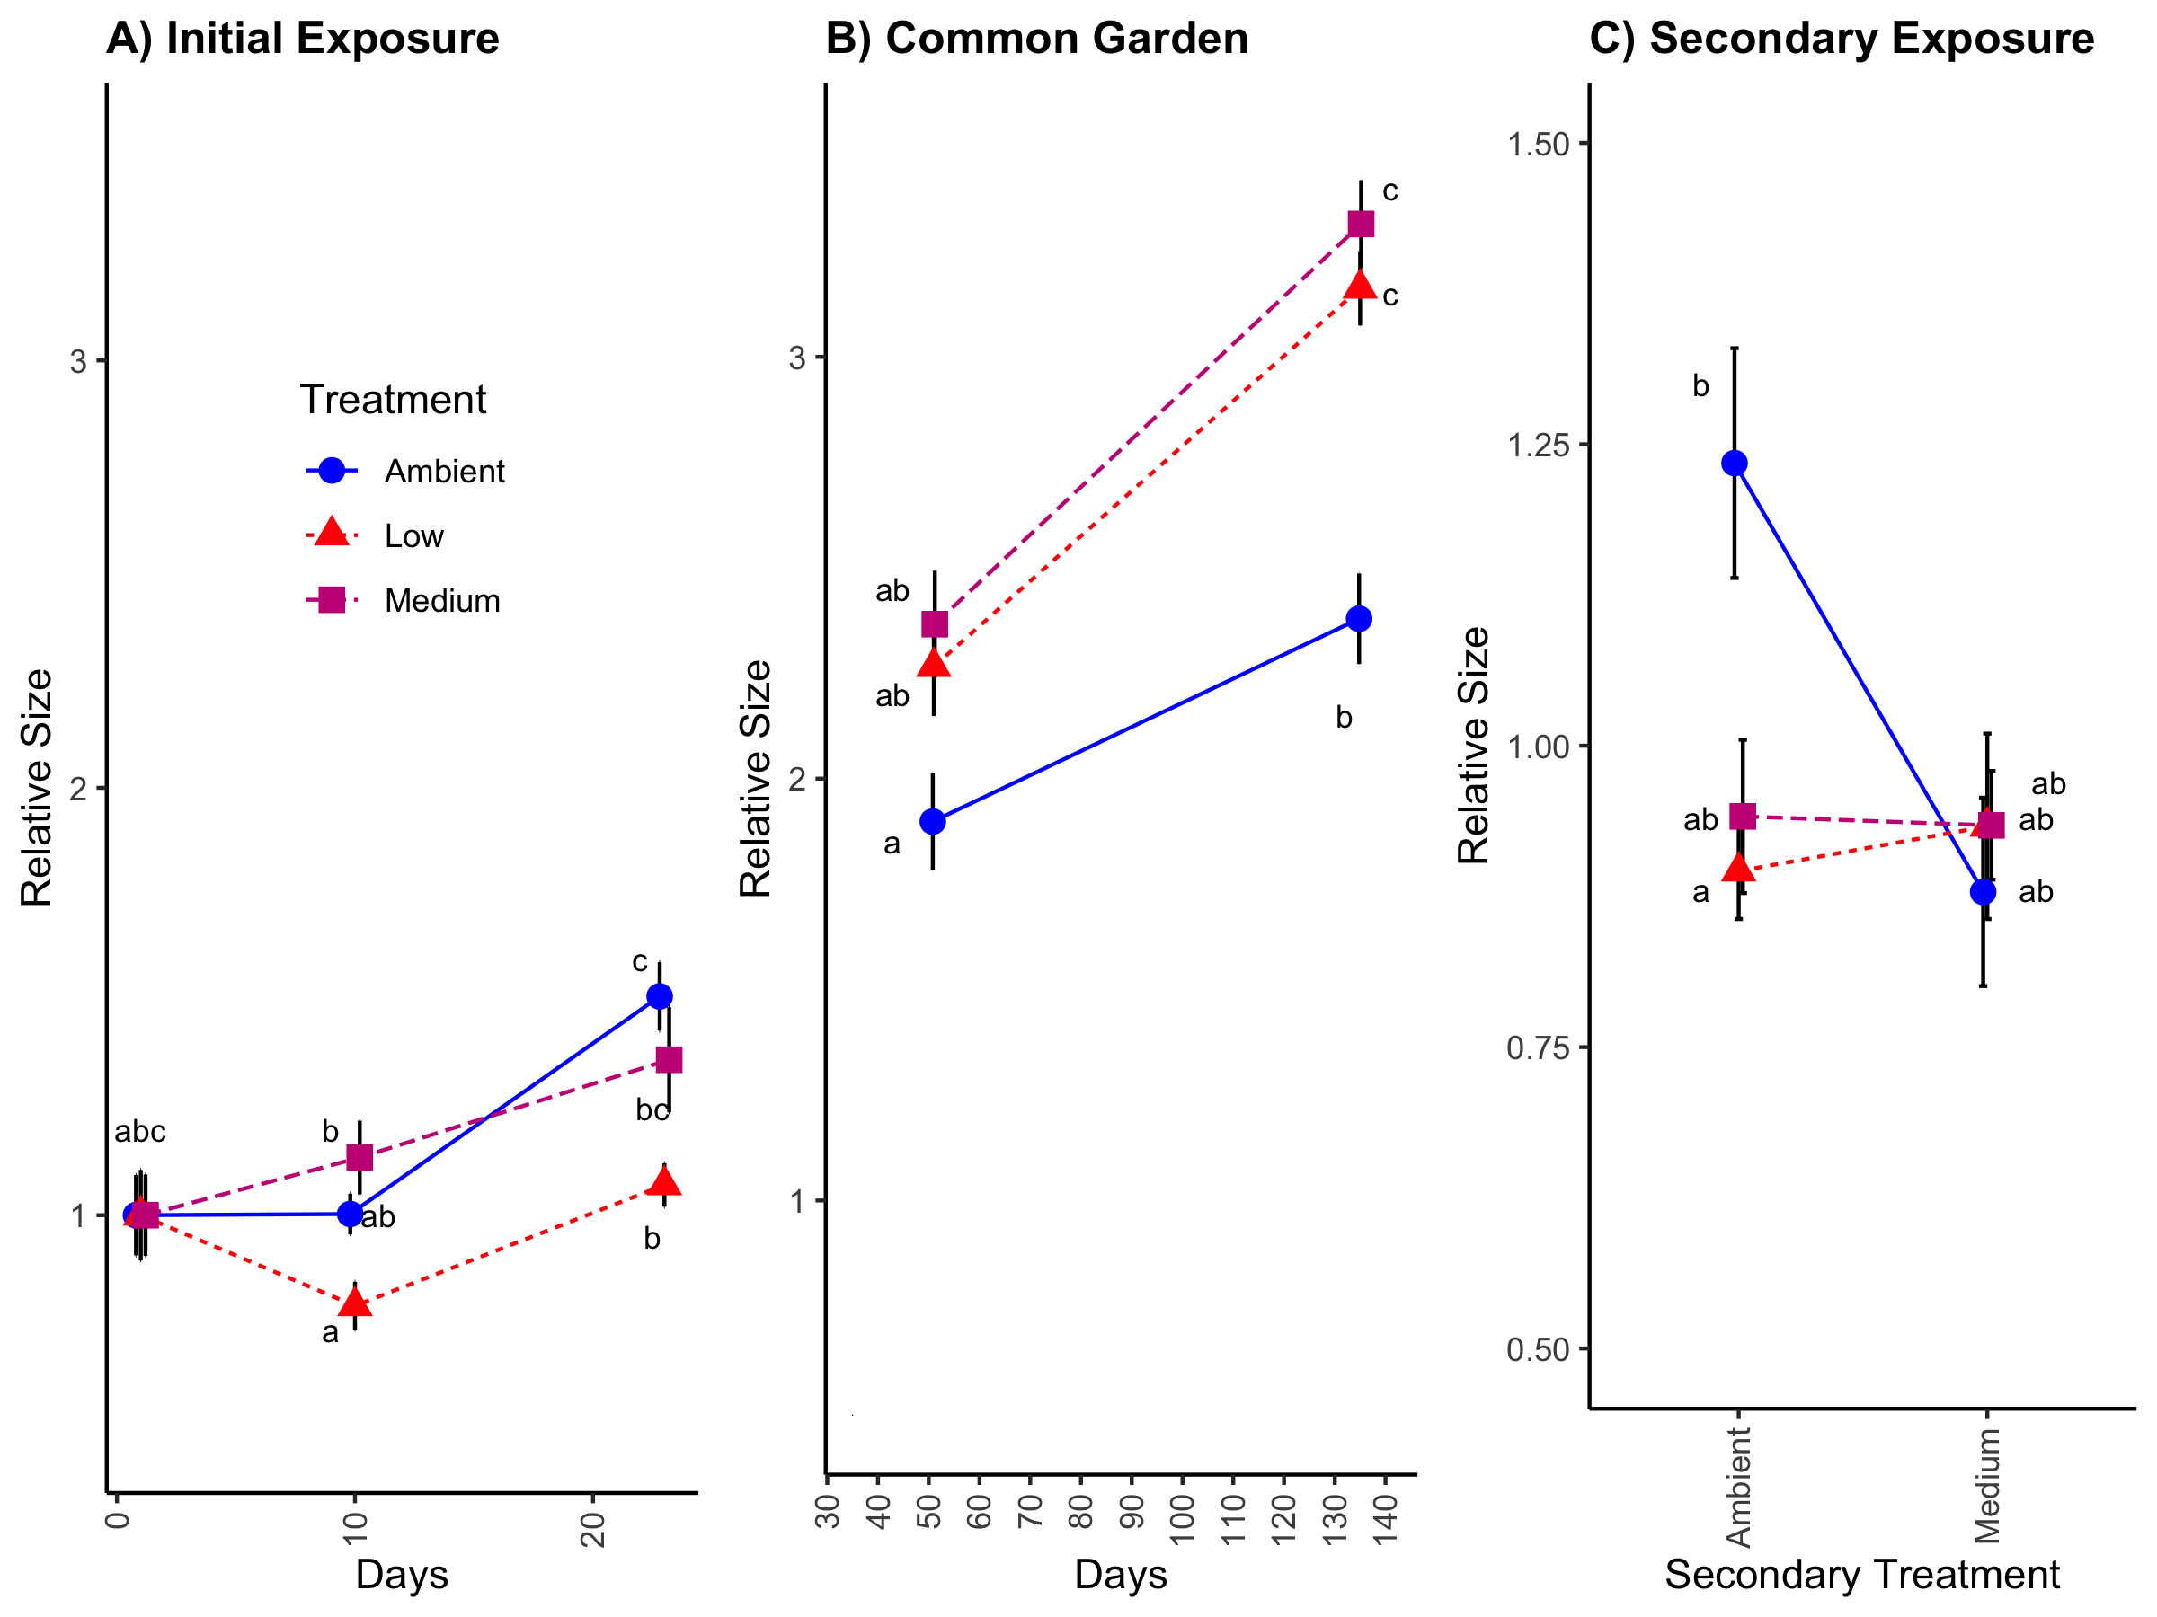
static moderate and low pH initial exposure protects against growth delay induced by secondary low pH exposure
Hollie Putnam
Notes:
To investigate possible molecular underpinnings of these growth phenotypes,

Slide 15
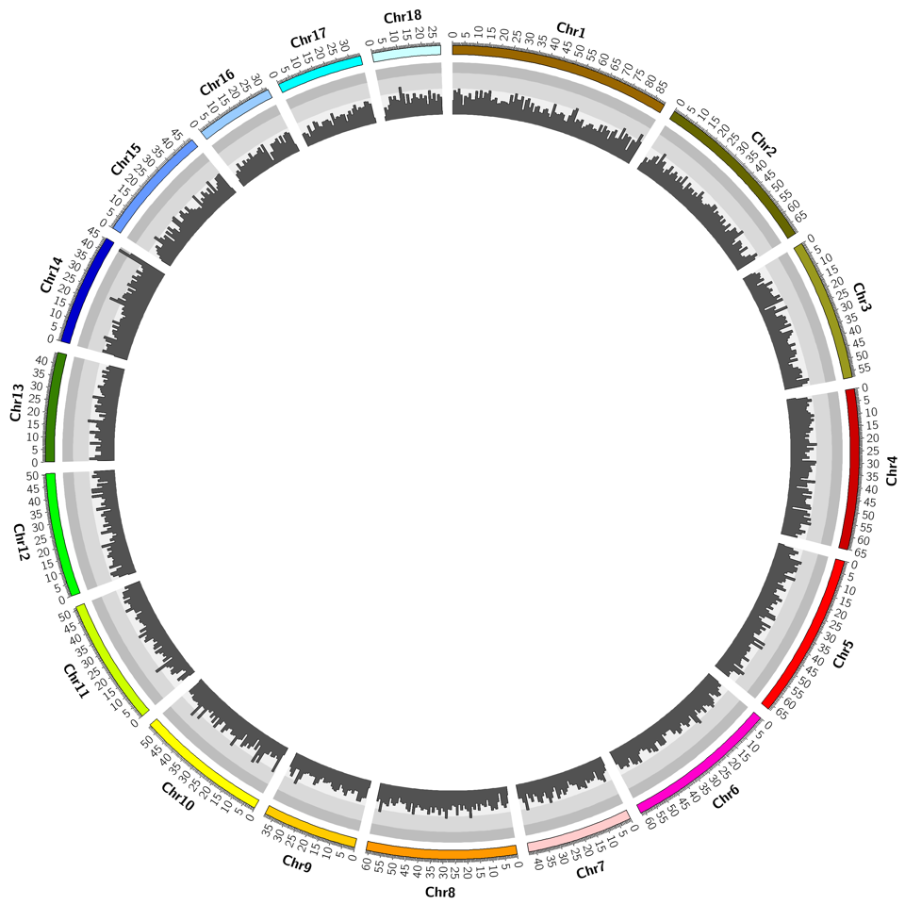
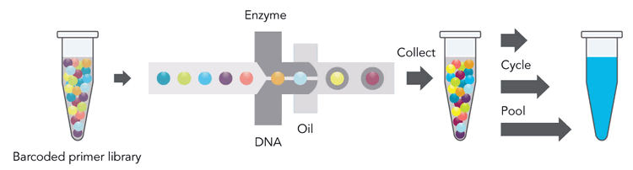
Sequencing the geoduck genome
10x Genomics
Linked-reads sequencing
Phase Genomics
Proximo Hi-C
18 Scaffolds
34,947 Genes
565,711 retro elements
259,955 transposons
42,601 sRNA
Notes:
We used 10x genomics technology of linked-reads sequencing coupled with phase genomics hi-C to assemble the geoduck genome. It consists of 18 scaffolds spanning 942 mbp, with 35K genes, Busco identified 71.5% complete single copy orthologs

Slide 16
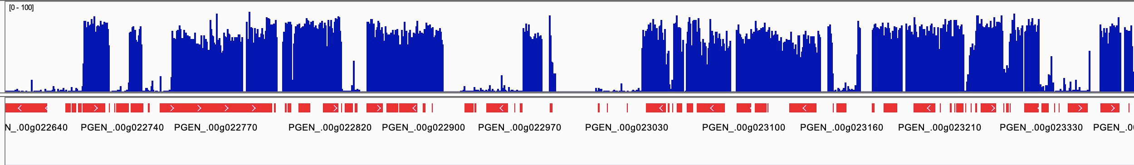
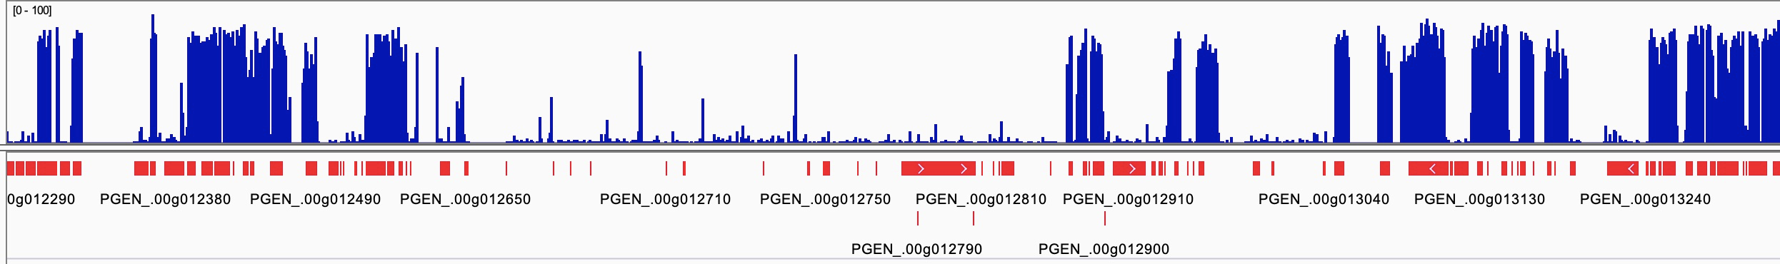
Geoduck genome methylation landscape
Notes:
This is a snap shot of the DNA methylation landscape of the genome which generally shows high methylation density within genes.

Slide 17
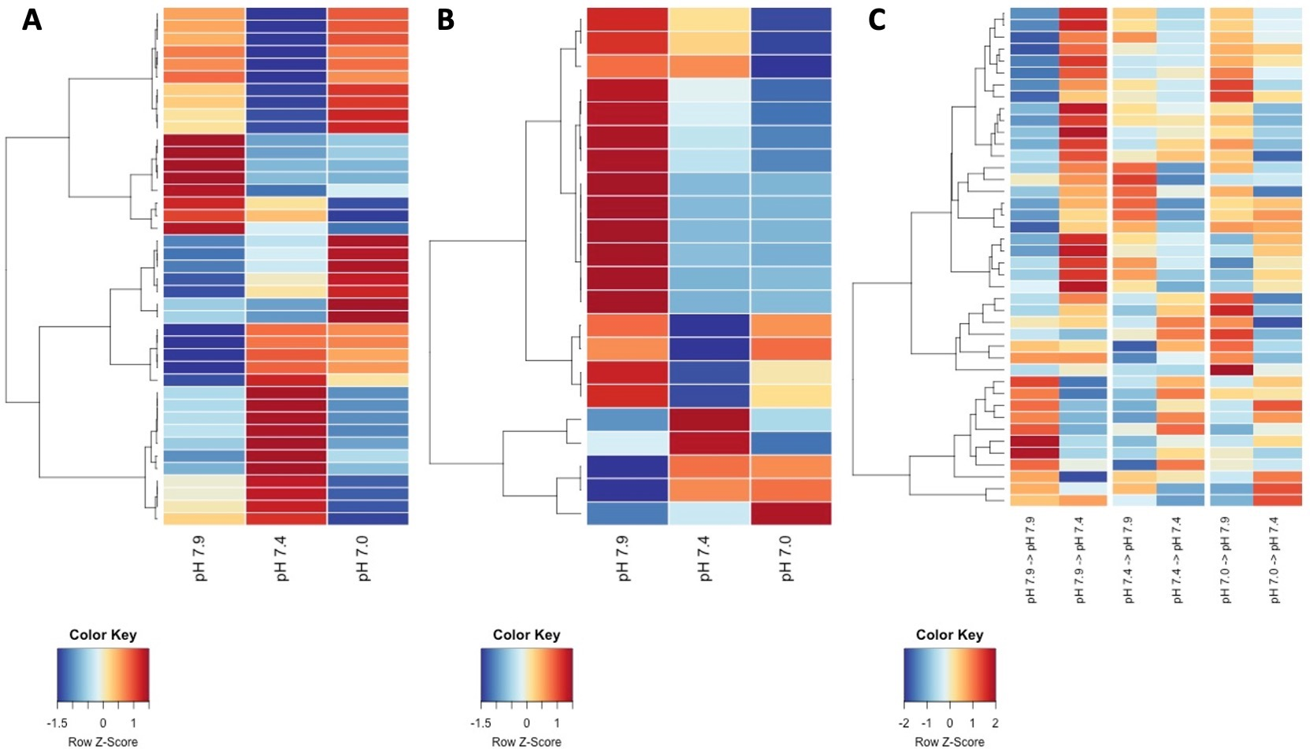
Differentially methylated regions across low pH conditions
After common garden (112 days post-exposure)
10 days of exposure
10 days of 2nd exposure
Notes:
Cytoskeleton activity related increased growth after common garden
Nucleic acid binding and mitochondria associated processes related to

Slide 18
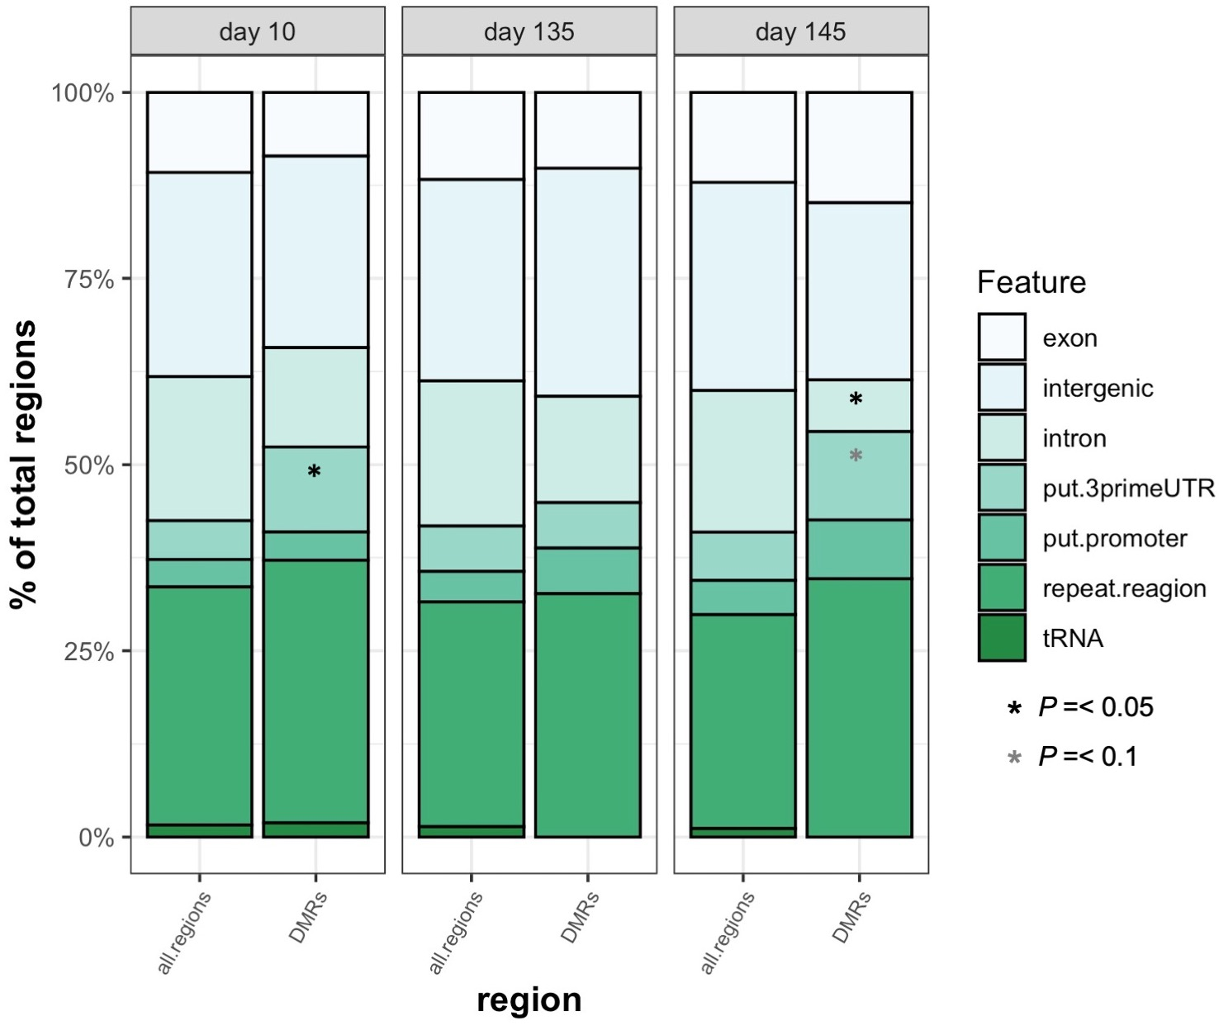
Differentially methylated regions across low pH conditions
After common garden (112 days post-exposure)
10 days of exposure
10 days of 2nd exposure
A
B
C
Notes:
Cytoskeleton activity related increased growth after common garden
Nucleic acid binding and mitochondria associated processes related to

Slide 19
Differentially methylated regions across low pH conditions
After common garden (112 days post-exposure)
10 days of exposure
10 days of 2nd exposure
A
B
C
Genes involved in cytoskeleton activity
Genes involved in nucleic acid binding and mitochondrial activity
Notes:
Cytoskeleton activity related increased growth after common garden
Nucleic acid binding and mitochondria associated processes related to

Slide 20
Impact of variable low pH on broodstock
Initial Exposure
Ambient
Ambient (7.6.-7.8)
Variable low pH (6.8-7.0)
Days:
95
0
46
Notes:
How will they fare in OA conditions predicted for the future? Could stress conditioning be beneficial in aquaculture?

Slide 21
Impact of variable low pH on broodstock
Notes:
How will they fare in OA conditions predicted for the future? Could stress conditioning be beneficial in aquaculture?

Slide 22
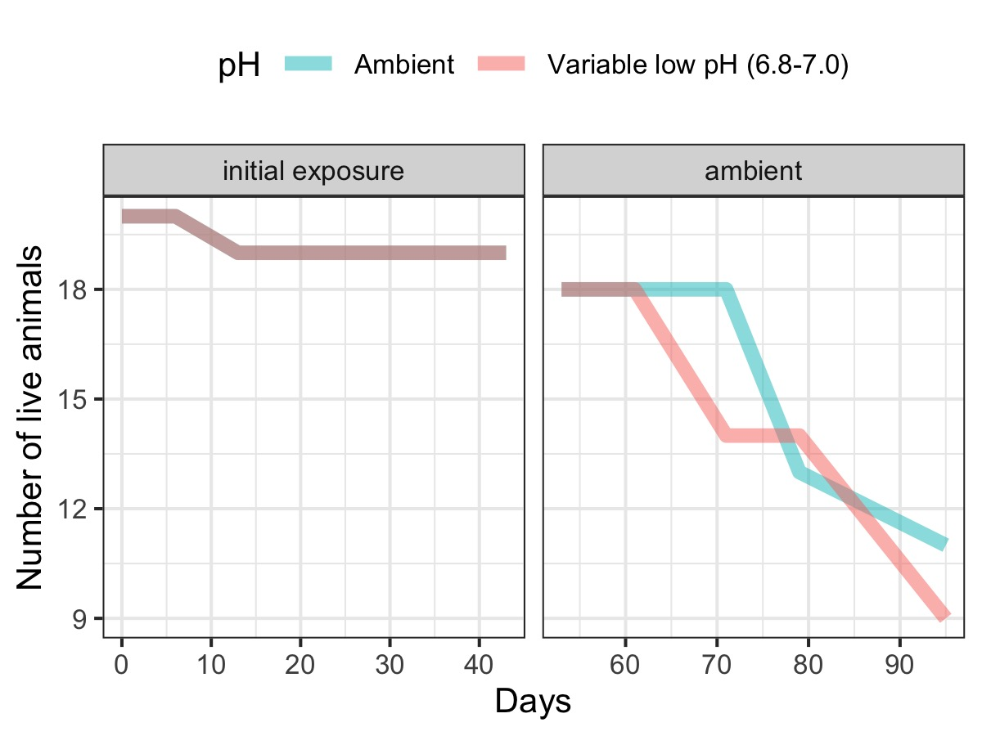
variable low pH does not affect broodstock survival
Notes:
How will they fare in OA conditions predicted for the future? Could stress conditioning be beneficial in aquaculture?

Slide 23
Impact of variable low pH on offspring development
Larval offspring reared under ambient conditions
Notes:
A significant interaction (treatment*age) had post-hoc differences for size on day 12 and 24 suggesting age-dependent effects of parental conditioning. Standard metabolic rate data shows patterns of higher mean respiration rates for larvae from ambient parents. Lower metabolic rates, but similar growth/development in larvae from stressed parents may have been due to lipid provisioning and/or methylation? Perhaps a good jumping point to run lipid indices and sequence our fixed eggs and larvae.

Slide 24

Generally little impact from parental conditioning on larval growth
Larval offspring reared under ambient conditions
Sam Gurr
Notes:
A significant interaction (treatment*age) had post-hoc differences for size on day 12 and 24 suggesting age-dependent effects of parental conditioning. Standard metabolic rate data shows patterns of higher mean respiration rates for larvae from ambient parents. Lower metabolic rates, but similar growth/development in larvae from stressed parents may have been due to lipid provisioning and/or methylation? Perhaps a good jumping point to run lipid indices and sequence our fixed eggs and larvae.

Slide 25
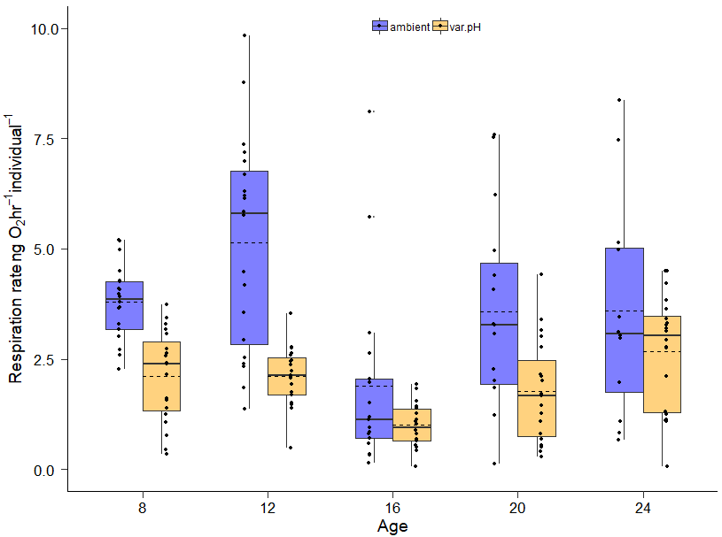
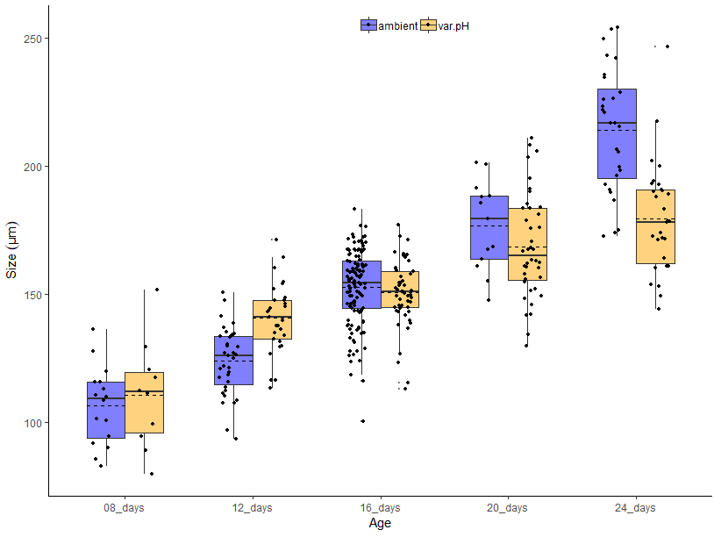
Parental variable low pH exposure leads to reduced metabolic rates in larvae
Larval offspring reared in ambient conditions
Metabolic rate over time
Growth over time
Days
Days
Sam Gurr
Notes:
A significant interaction (treatment*age) had post-hoc differences for size on day 12 and 24 suggesting age-dependent effects of parental conditioning. Standard metabolic rate data shows patterns of higher mean respiration rates for larvae from ambient parents. Lower metabolic rates, but similar growth/development in larvae from stressed parents may have been due to lipid provisioning and/or methylation? Perhaps a good jumping point to run lipid indices and sequence our fixed eggs and larvae.

Slide 26
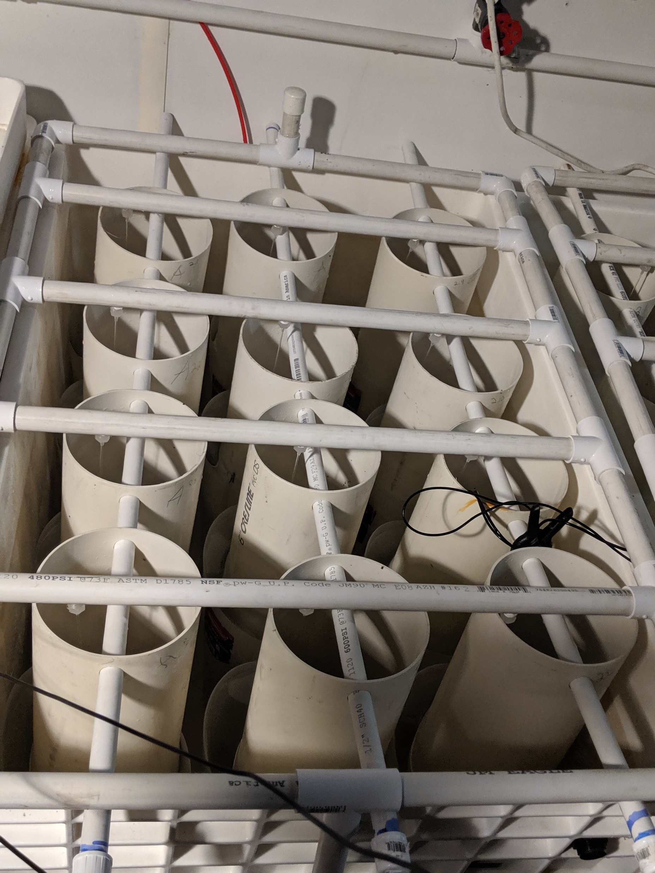
Impact of variable low pH on juvenile offspring development
Juvenile offspring
~ 100 juveniles per silo
Ambient (7.6-7.8)
44 days
Variable low pH (6.8-7.0)
Notes:
How will they fare in OA conditions predicted for the future? Could stress conditioning be beneficial in aquaculture?

Slide 27
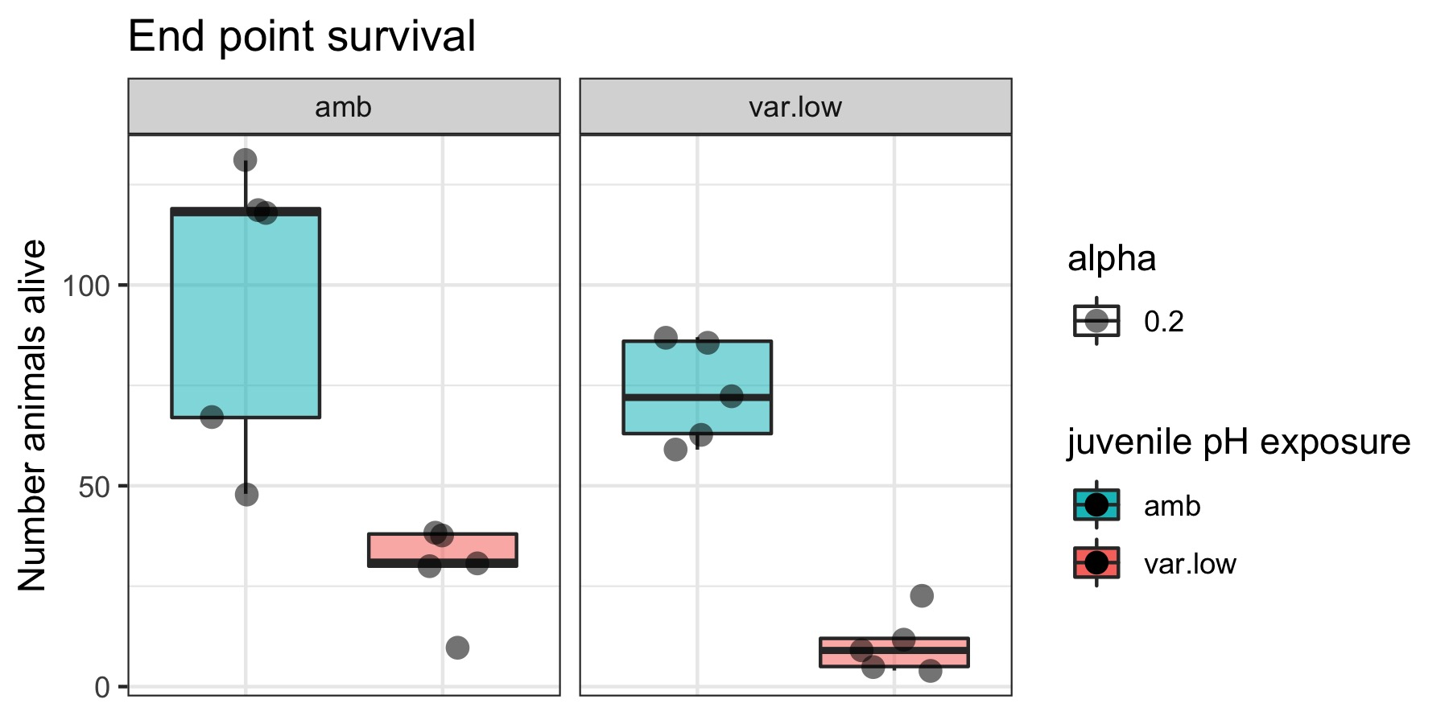
Variable low pH exposure led to lower survival regardless of parental conditions
Juvenile offspring
Ambient (7.6-7.8)
Significant effect from juvenile conditions (P = 6.69e-06)
Marginal effect from parental conditions (P = 0.0863)
44 days
Variable low pH (6.8-7.0)
Linear mixed effect model:
# live animals ~ Parental condition + pH exposure + (1 | Silo)
Notes:
How will they fare in OA conditions predicted for the future? Could stress conditioning be beneficial in aquaculture?

Slide 28
Parental and juvenile variable low pH exposure led to larger size
Juvenile offspring
Ambient (7.6-7.8)
Endpoint size distribution
44 days
Variable low pH (6.8-7.0)
Notes:
How will they fare in OA conditions predicted for the future? Could stress conditioning be beneficial in aquaculture?

Slide 29
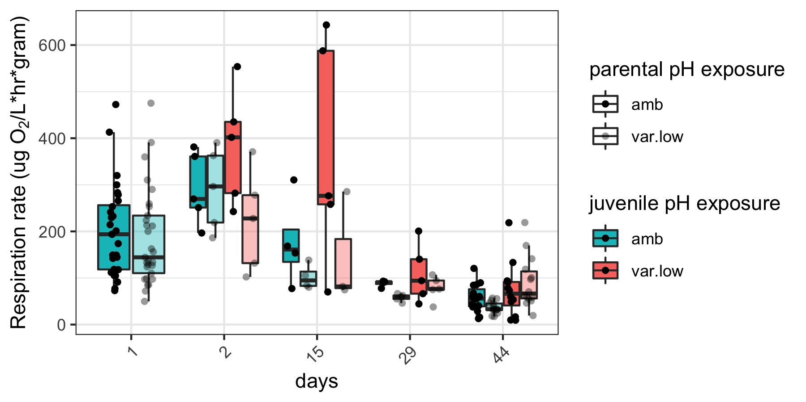
Parental variable low pH exposure generally led to lower metabolic rate in juveniles
Juvenile offspring
Metabolic rate over time
Ambient (7.6-7.8)
44 days
Variable low pH (6.8-7.0)

Slide 30
Summary
Broodstock and reproductive development
Longer duration and constant low pH exposure is more detrimental to survival
Female reproductive development is more sensitive to low pH than males
Juvenile development
Evidence for environmental memory
Initial low pH exposure led to larger animals 4 months after exposure
associated with methylation changes in genes related to cytoskeletal activity
Initial low pH exposure prevented growth delay seen in naïve juveniles
associated with methylation changes in genes related to nucleic acid binding and mitochondrial activity
Carry over effects
Parental variable low pH conditioning leads to reduced energy demand in offspring that achieve the same or larger size under low pH conditions
Generally didn’t impact larval growth
Led to reduced metabolic rates in larvae
Didn’t impact survival in juveniles exposed to variable low pH
Led to larger size juveniles when exposed to variable low pH
Generally led to lower metabolic rate in juveniles
Notes:
something to say about the future

Slide 31
Implications
pH can be used to induce beneficial traits that persist over time
Effects seems to be stage dependent
Conditions need to be optimized
Message me on the Pathable SICB meeting platform (Shelly Trigg)
Email me at strigg@uw.edu
Questions?

